Slide 1
What is a build management tool
Sample tools
Jenkins
Team city
Bamboo

Slide 2
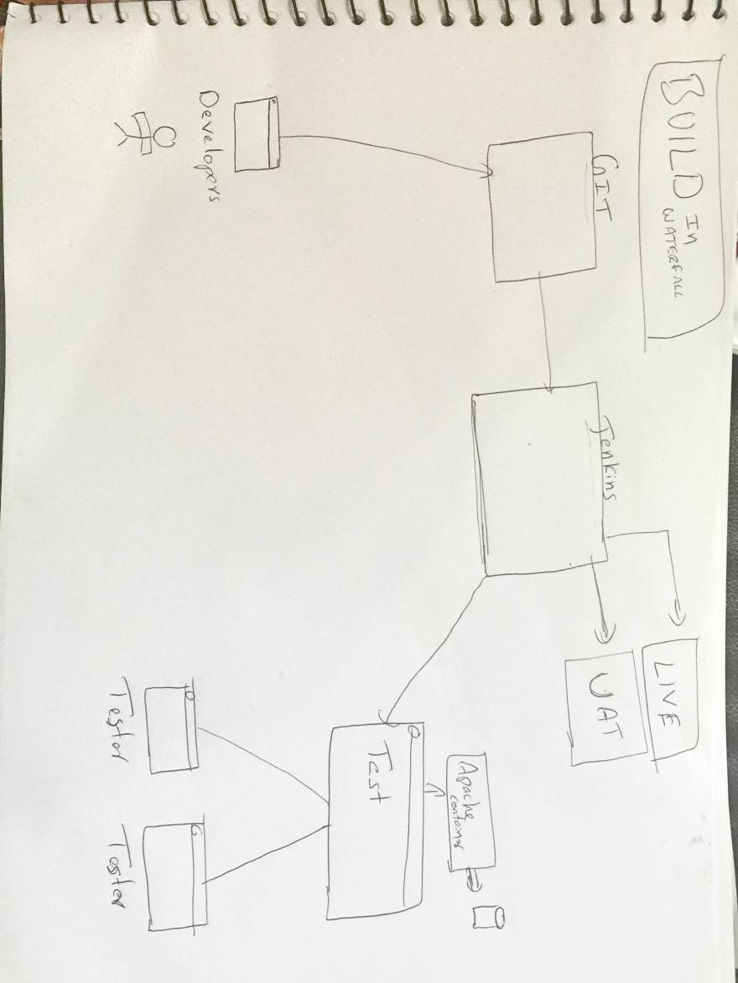
How a water fall model builds deployed

Slide 3
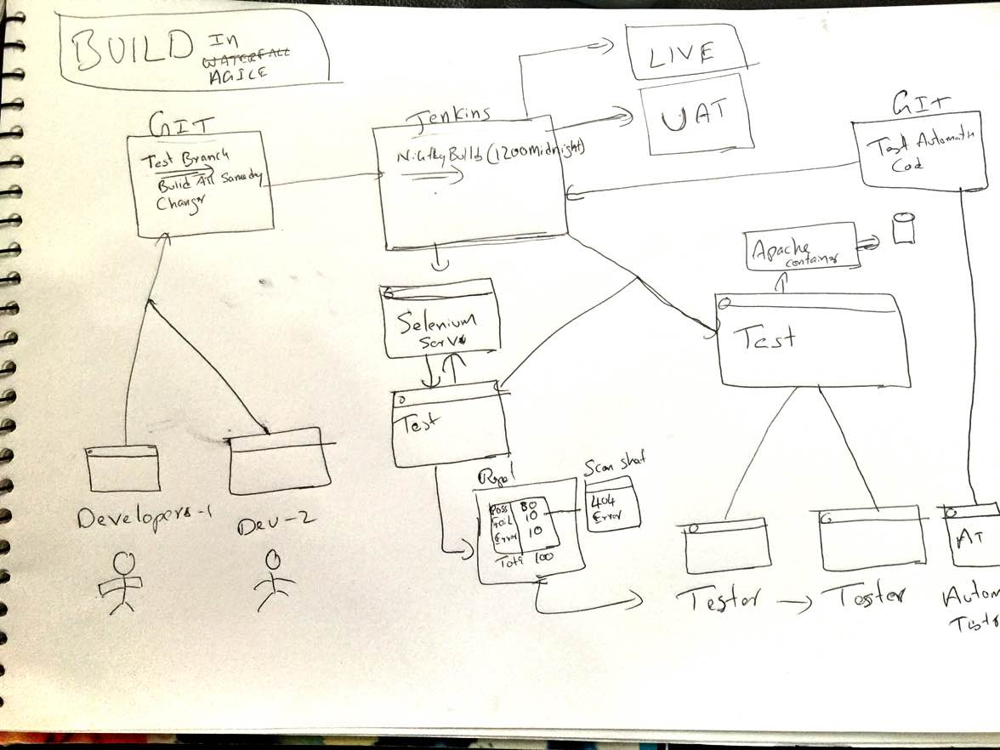
How a agile builds deployed and role of test automation as Quality gates

Slide 4
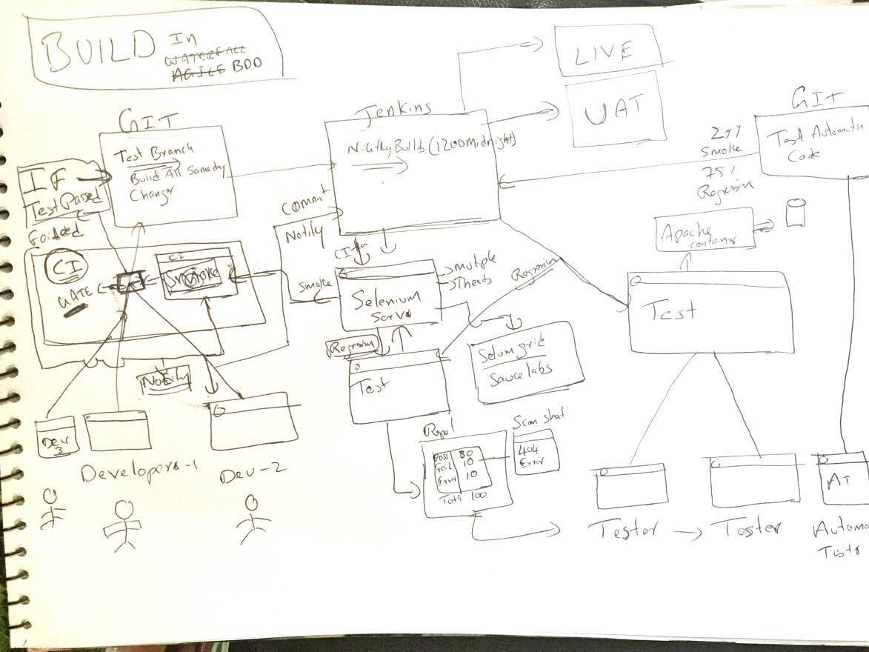
How a BDD builds Deployed and role of test automation as quality gates

